Slide 1

Heuristics and the
bias-variance trade-off
Notes on Behavioural Economics
Jason Collins

Slide 2


Slide 3


Slide 4
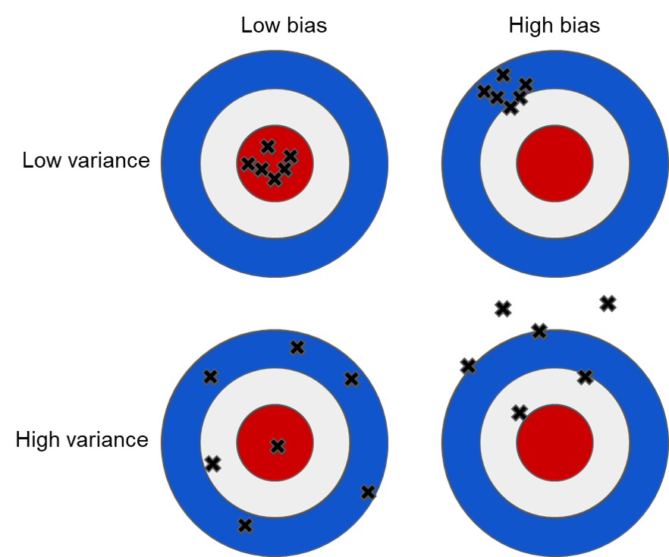

Slide 5
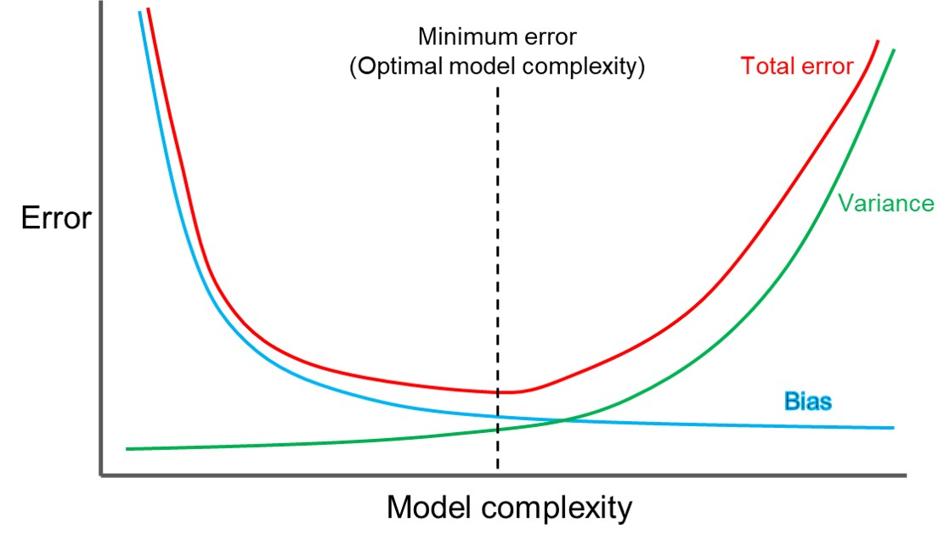

Slide 6
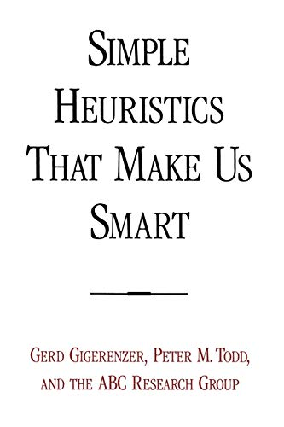

Slide 7
